Slide 1



Heart
Disease
BIGGER THEN DATA (BTD)
Afnan Alzahrani (Speaker)
Batool Alhajaji (Speaker)
Amjad Almusallam
Mahmoud Alhassan
Abdullah Alhuwaishel
Jumana Almussa

Slide 2
About Dataset
Data Engineering
Exploratory Data Analysis (EDA)
Multi-Linear Regression
Logistic regression
Introduction

Slide 3

About
Dataset
4238 rows × 16 columns
Sex, Age, Current Smoker, Cigs Per Day,
BP Meds, Prevalent Stroke, Prevalent Hyp,
Diabetes, Tot Chol, Sys BP, Dia BP, BMI, Heart Rate, Glucose, TenYearCHD, Education

Slide 4

Data Engineering
Handling missing values
Most frequent
Mean
Median
Drop

Slide 5
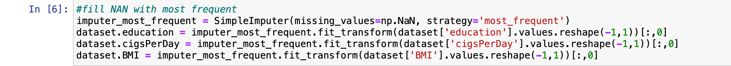
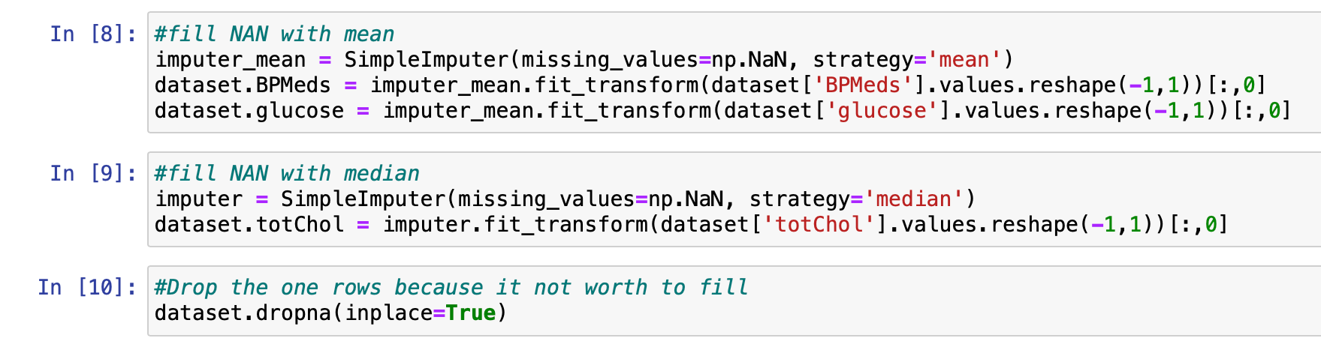
Handling missing values

Slide 6
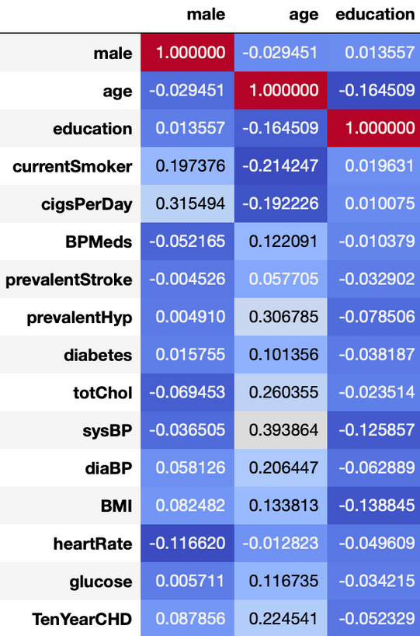
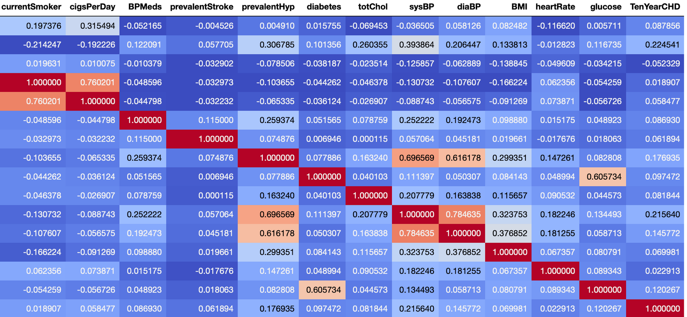
Correlation

Slide 7
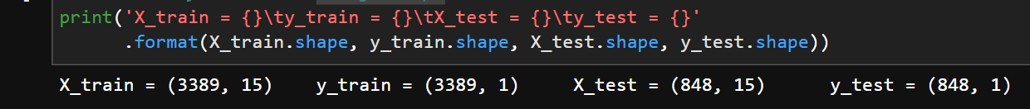
Multi-Linear Regression
-Choosing features and target:"sysBP"',
-Split data into train and test set
-using .shape

Slide 8
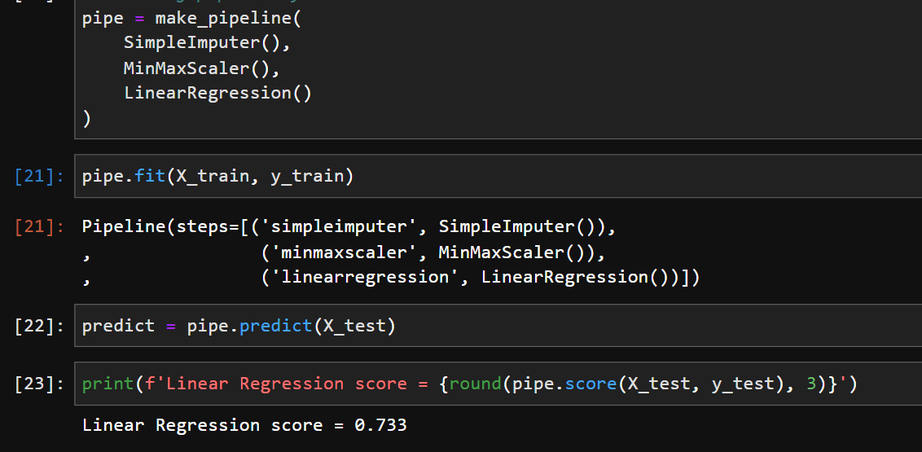
Multi-Linear Regression
-Pipeline

Slide 9
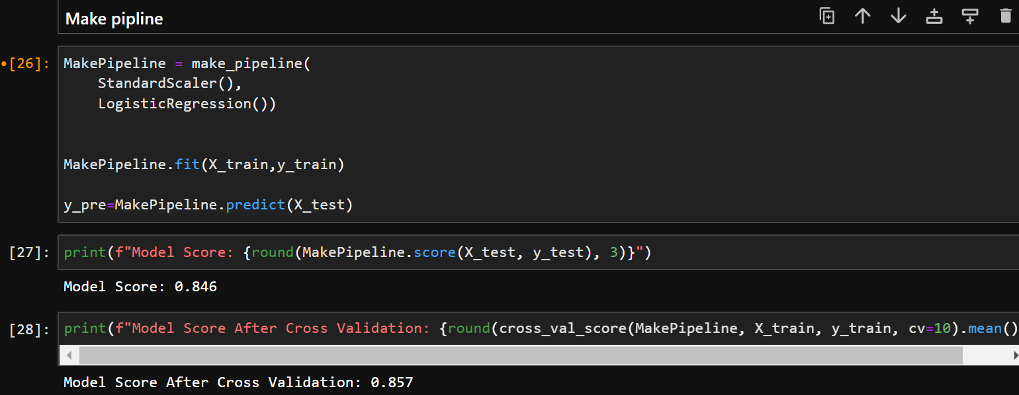
Logistic regression
-Choosing features and target:"'TenYearCHD'"',
-Split data into train and test set
-Make pipeline

Slide 10
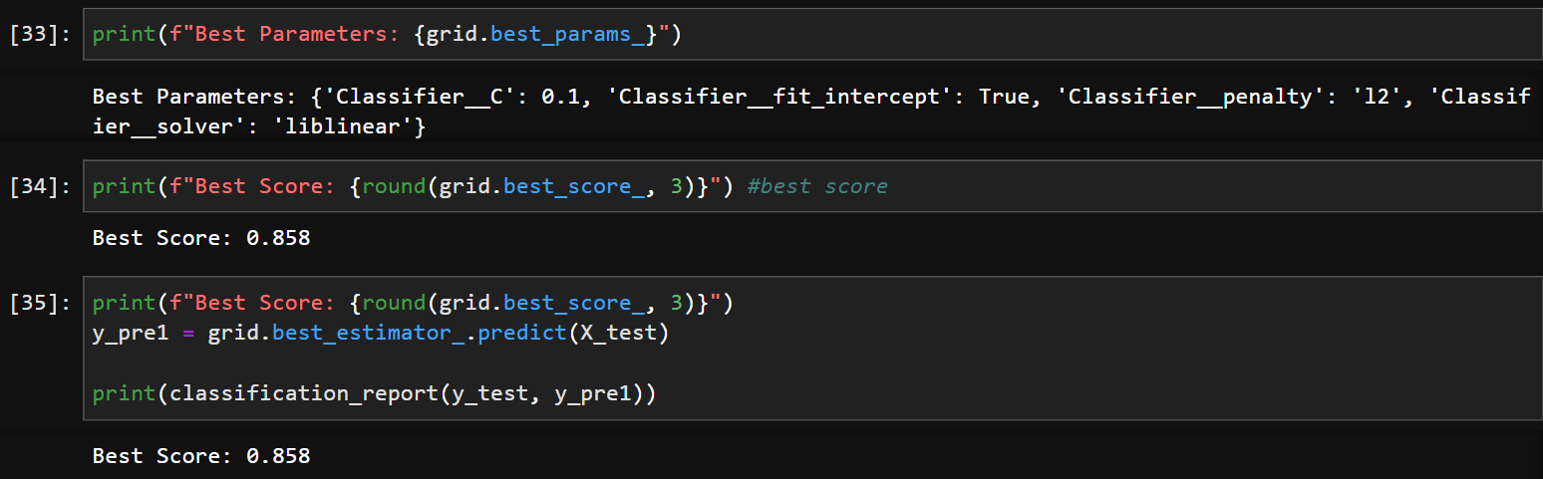
Logistic regression
-create hyperparameter
-Best Parameters
-Best Score

Slide 11
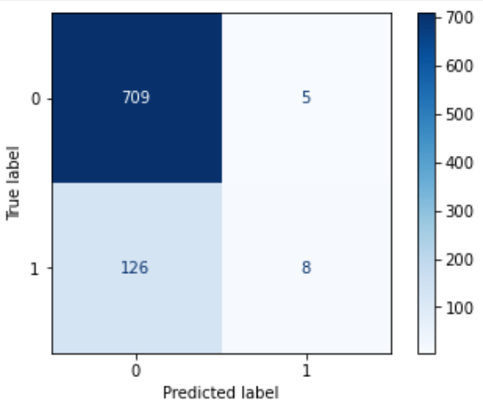
Logistic regression
"plot confusion matrix"

Slide 12



Thank you for listening !
And don't forget to stay healthy

